Slide 1
JAGGAER PROCUREMENT FORM TRAINING GUIDE
August 2025

Slide 2
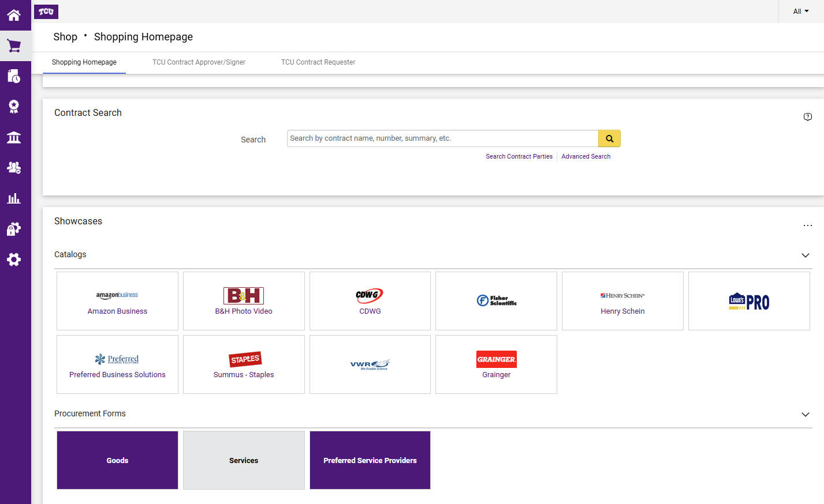
Definition: Procurement Form means a requisition to purchase a good or services that is NOT available on a Jaggaer Catalog.
There are two roles to work in Jaggaer:
1. Requestor – Creates and submits purchases for goods and services related to their department.
2. Approver – Reviews and authorized financial transactions for the purchase of goods and service related to their department.
Select the appropriate Non-Catalog form below (Goods, Service or Preferred Services Providers)

Slide 3
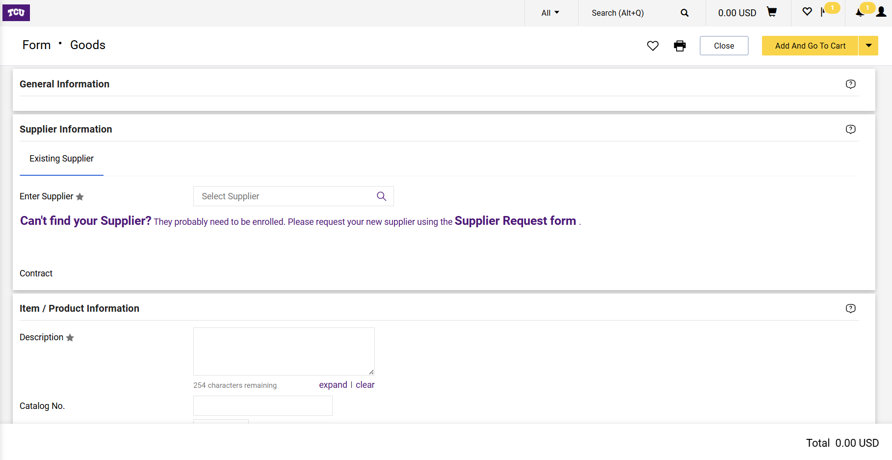
Once one of the forms is clicked, enter the names of the supplier. Confirm that the supplier has an email address to send the purchase order electronically.

Slide 4
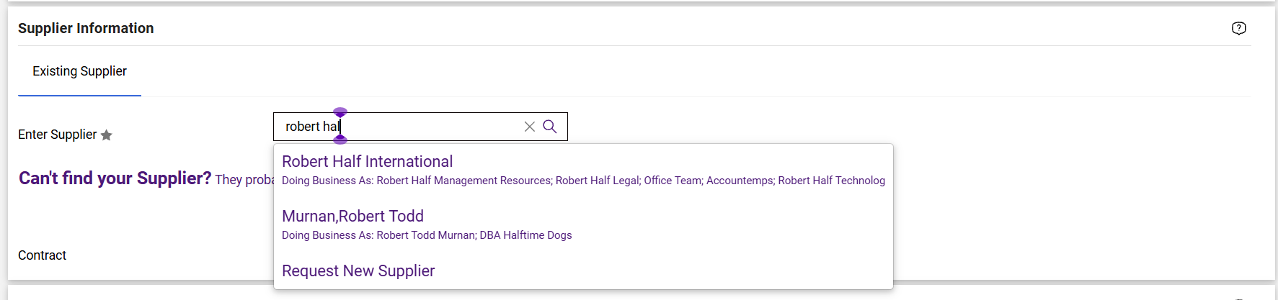
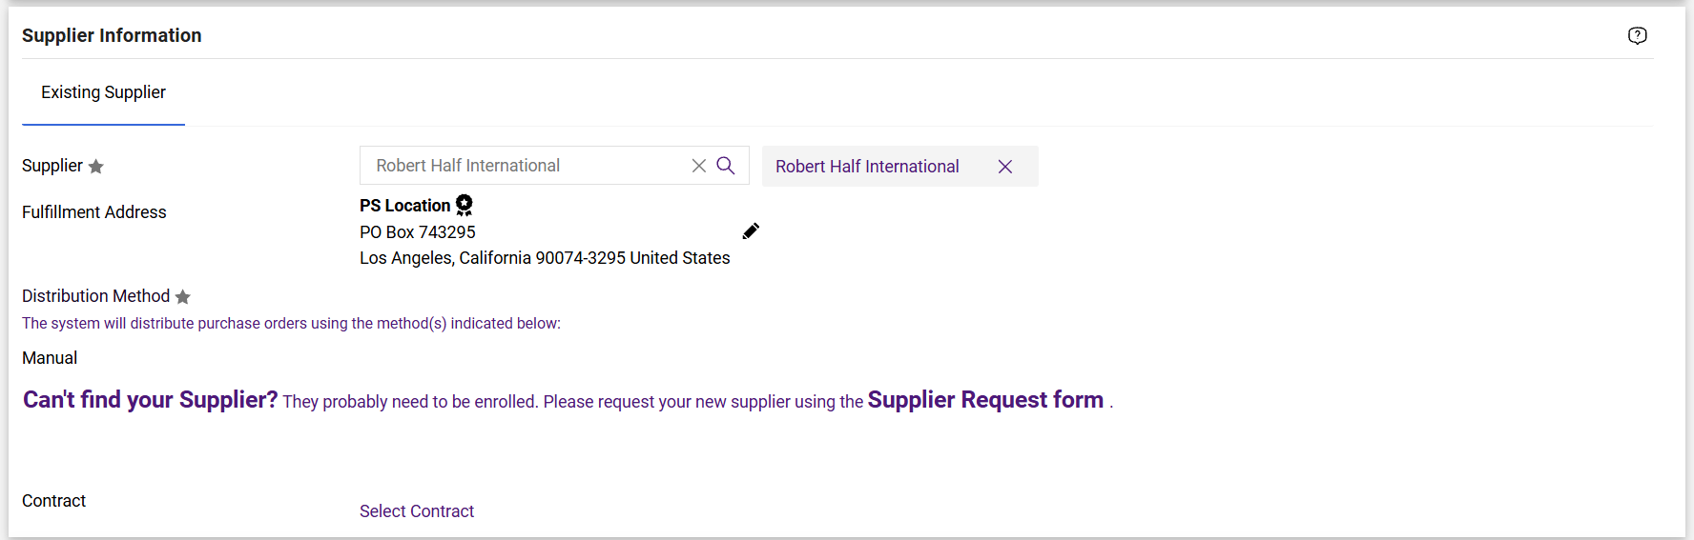
Select the correct supplier. Confirm that the supplier’s address is correct. Some supplier may have multiple addresses, click on the “pencil” to the right if the initial address populated is incorrect.

Slide 5
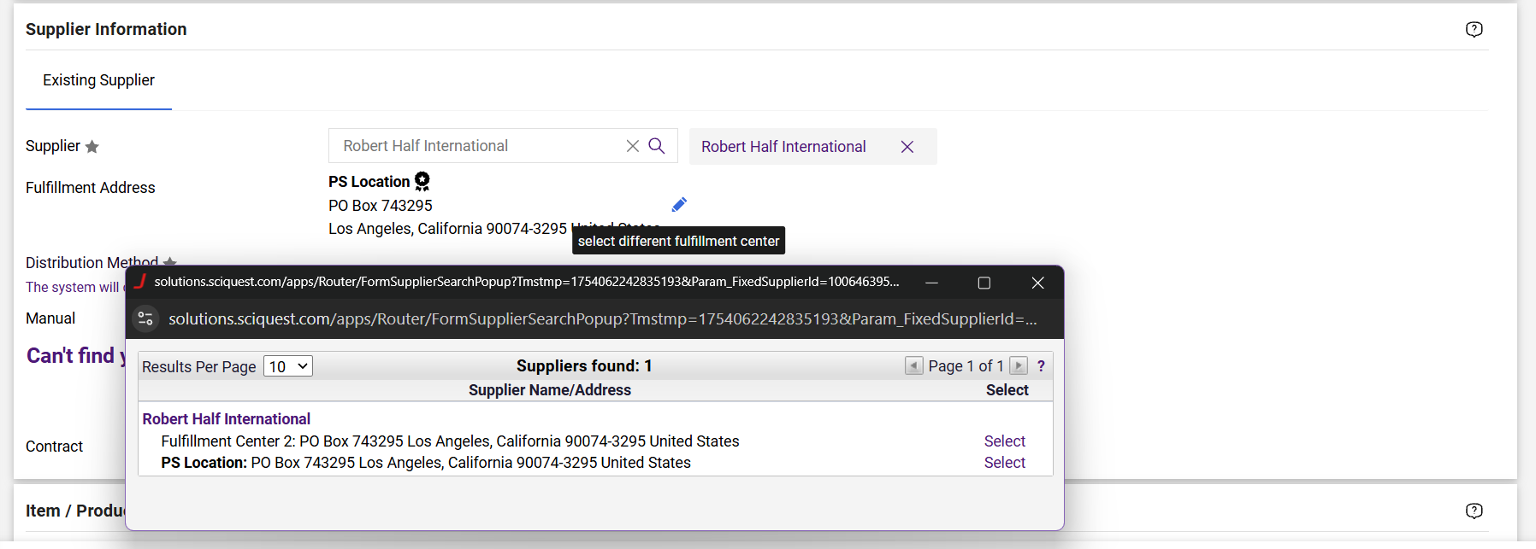
When the pencil is selected, a list of addresses associated with the supplier will appear, “select” the correct address associated with this order.

Slide 6
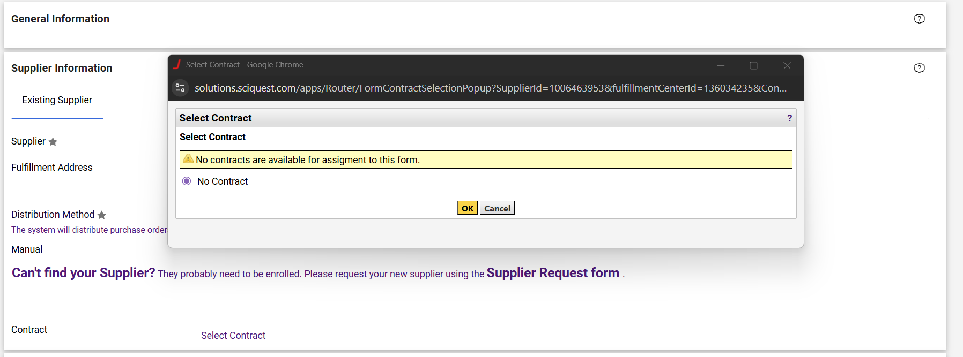
If a Contract has been executed between the parties, attach the Contract to the requisition. You can search for the Contract and select the correct Contract from the list.

Slide 7
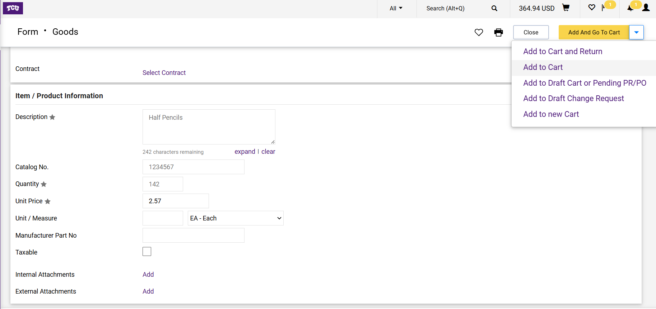
Fill out the form as requested. The details entered should “match” exactly the quote that the supplier has provided. If you quote as multiple lines/charges, select “Add to Cart and Return” and continue until all lines are added.
Please note that if Goods requistion form is selected, each item on the quote will have to be entered on its own individual lines.

Slide 8
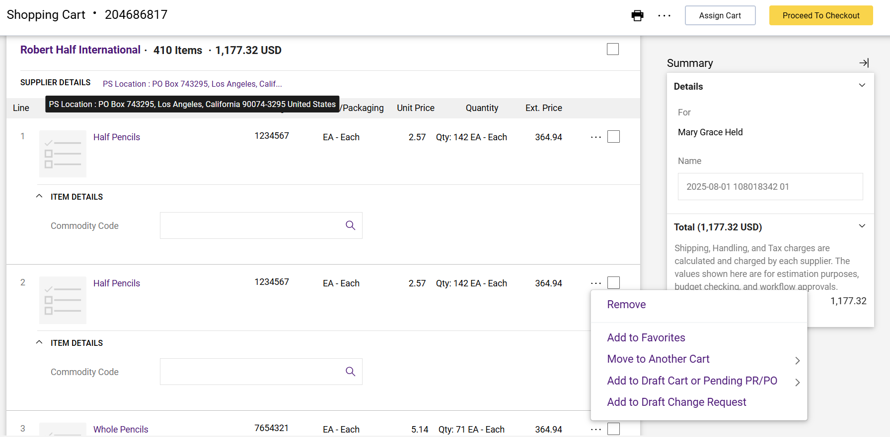
Once all the lines of the order are added to the requisition, review to ensure that it is correct.
If a line needs to be edited or removed, you may do so by selecting the “…” by the line.

Slide 9
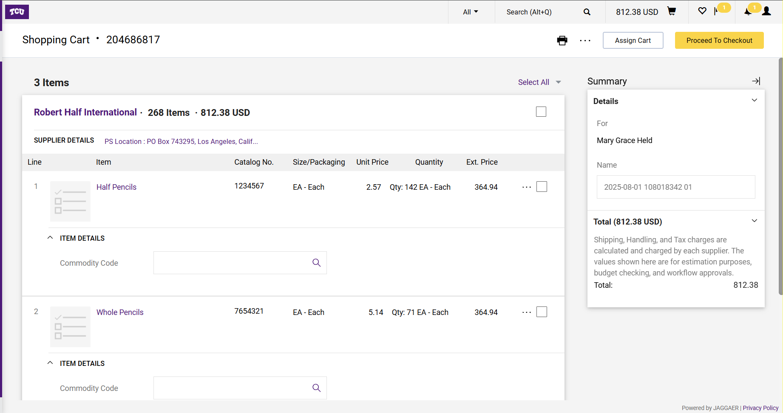
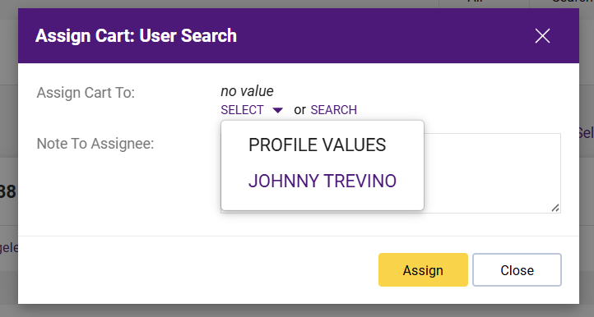
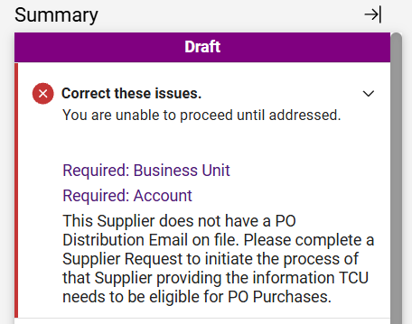
If the individual who is making this request is not a Requester, must “Assign Cart” to a Requester to finalize the requisition. Once the assign cart is clicked, search and select the correct Requester. If there are any “errors/issues” correct the issues in order to Proceed to Checkout.

Slide 10
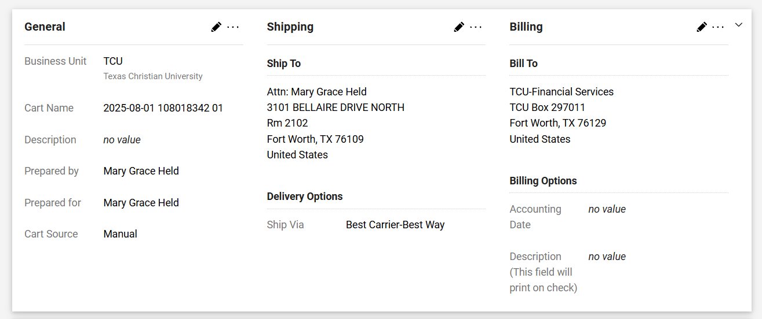
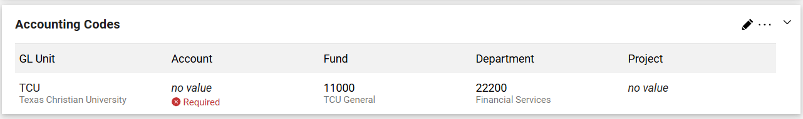
Confirm the Shipping/delivery address and Accounting Codes are correct. If they need to be revised select the “pencil” by those sections to revise.

Slide 11
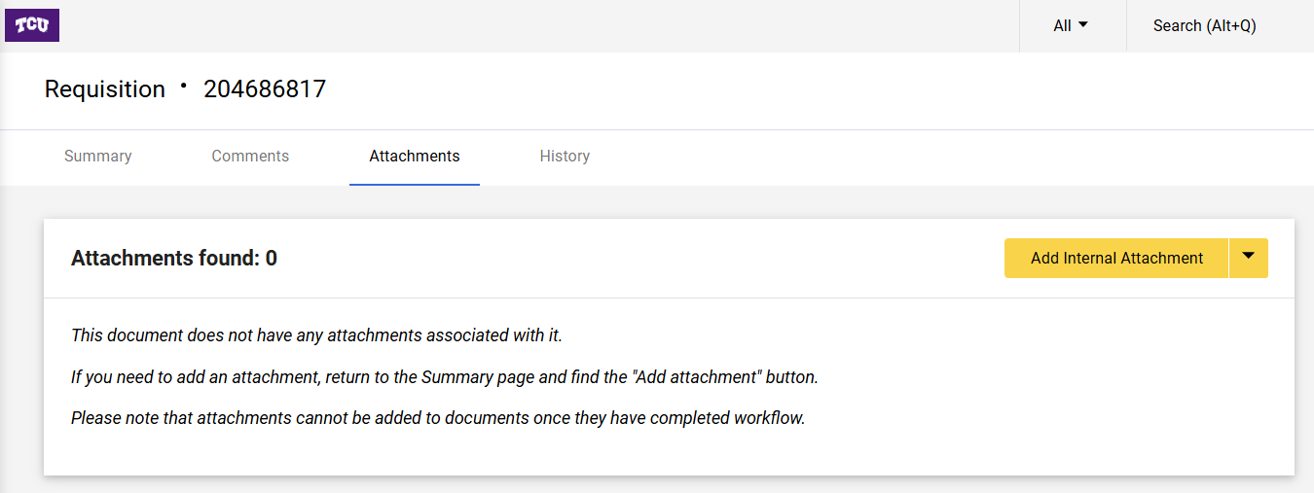
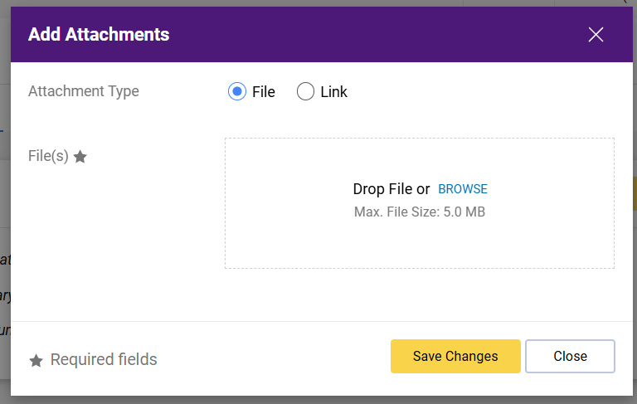
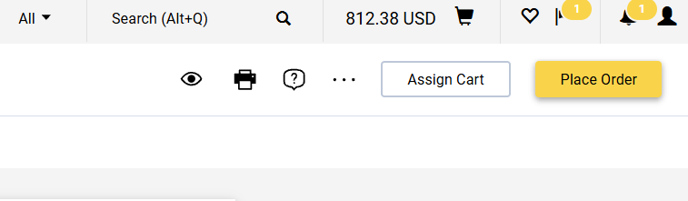
A quote or other document must be attached to substantiate the purchase. Select the “Attachments” tab at the top-middle to drag your document into the requisition. Then select “Place Order” once completed.

Slide 12
FINAL STEP
Manual Invoice Process
NOTE: BE SURE TO WRITE THE ORIGINAL PURCHASE ORDER NUMBER ON THE INVOICE IF NOT ALREADY IDENTIFIED.
Locate your purchase order (PO) in Jaggaer
Go to the 'Invoices' tab at the top. Click the “+” sign.
Fill in the Supplier Invoice Number and the Invoice Date.
Confirm that the invoice total matches, if not, scroll to each line item to revise accordingly to match.
Then select “Save”
Go to the ‘Attachments’ tab located at top-middle of the page and attach a copy of the Invoice
Select 'Complete' at the top right of the page to submit the invoice.
NOTE: REFER TO THE SEPARATE MANUAL INVOICE STEP BY STEP GUIDE FOR MORE DETAILED INSTRUCTIONS AND SCREENS.

Slide 13
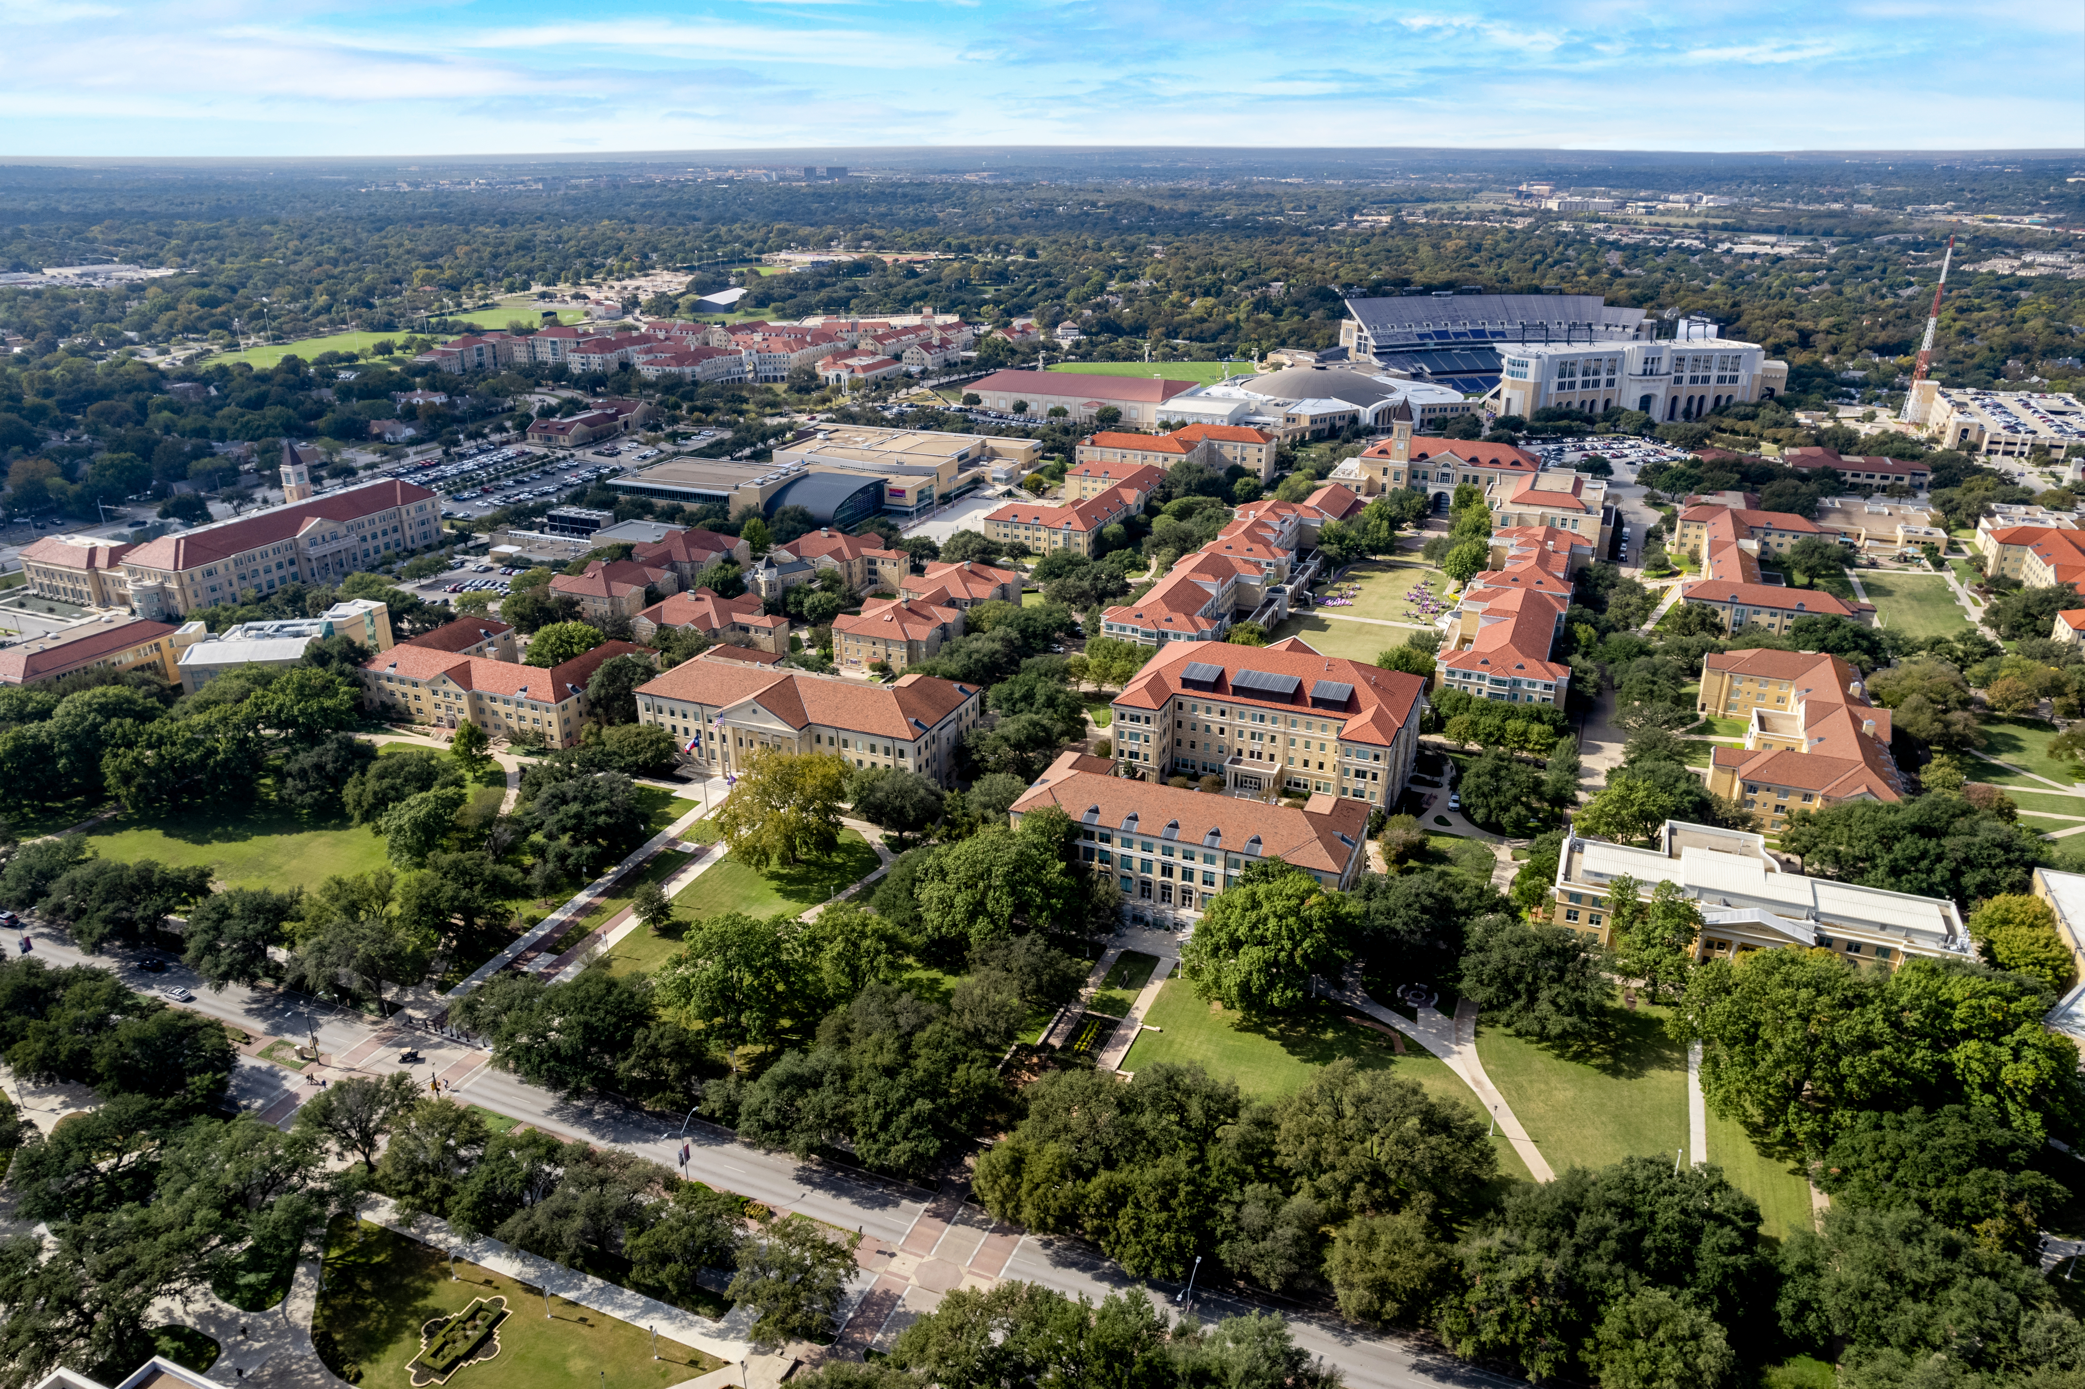
QUESTIONS?
Submit to procurement@tcu.edu

