Slide 1
JAGGAER PROCUREMENT FORM “MANUAL INVOICE” TRAINING GUIDE
August 2025

Slide 2
Non-Catalog Manual Invoice Process
NOTE: BE SURE TO WRITE THE ORIGINAL PURCHASE ORDER NUMBER ON THE INVOICE IF NOT ALREADY IDENTIFIED.
NOTE: BE SURE TO WRITE THE ORIGINAL PURCHASE ORDER NUMBER ON THE INVOICE IF NOT ALREADY IDENTIFIED.
Locate your purchase order (PO) in Jaggaer
Go to the 'Invoices' tab at the top. Click the “+” sign.
Fill in the Supplier Invoice Number and the Invoice Date.
Confirm that the invoice total matches, if not, scroll to each line item to revise accordingly to match.
Then select “Save”
Go to the ‘Attachments’ tab located at top-middle of the page and attach a copy of the Invoice
Select 'Complete' at the top right of the page to submit the invoice.

Slide 3
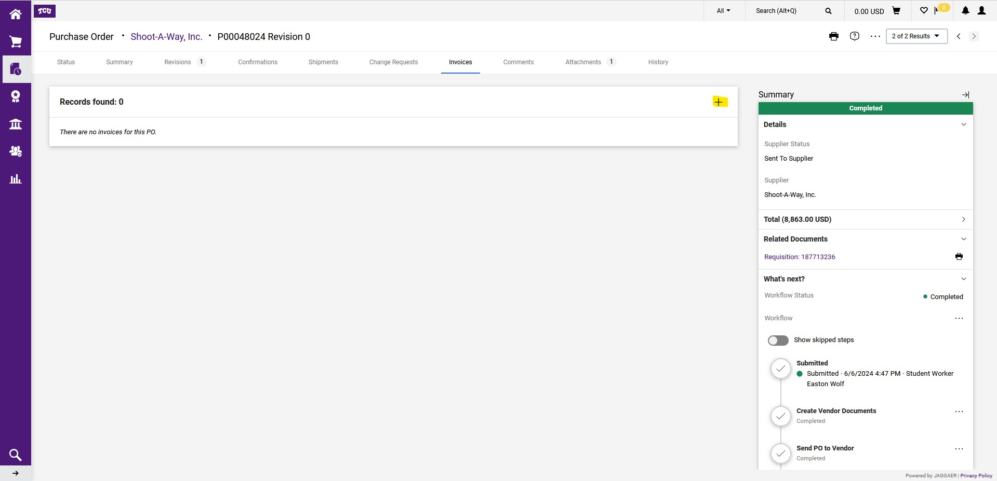
On the 'Invoices' tab at the top then Click the “+” sign.

Slide 4
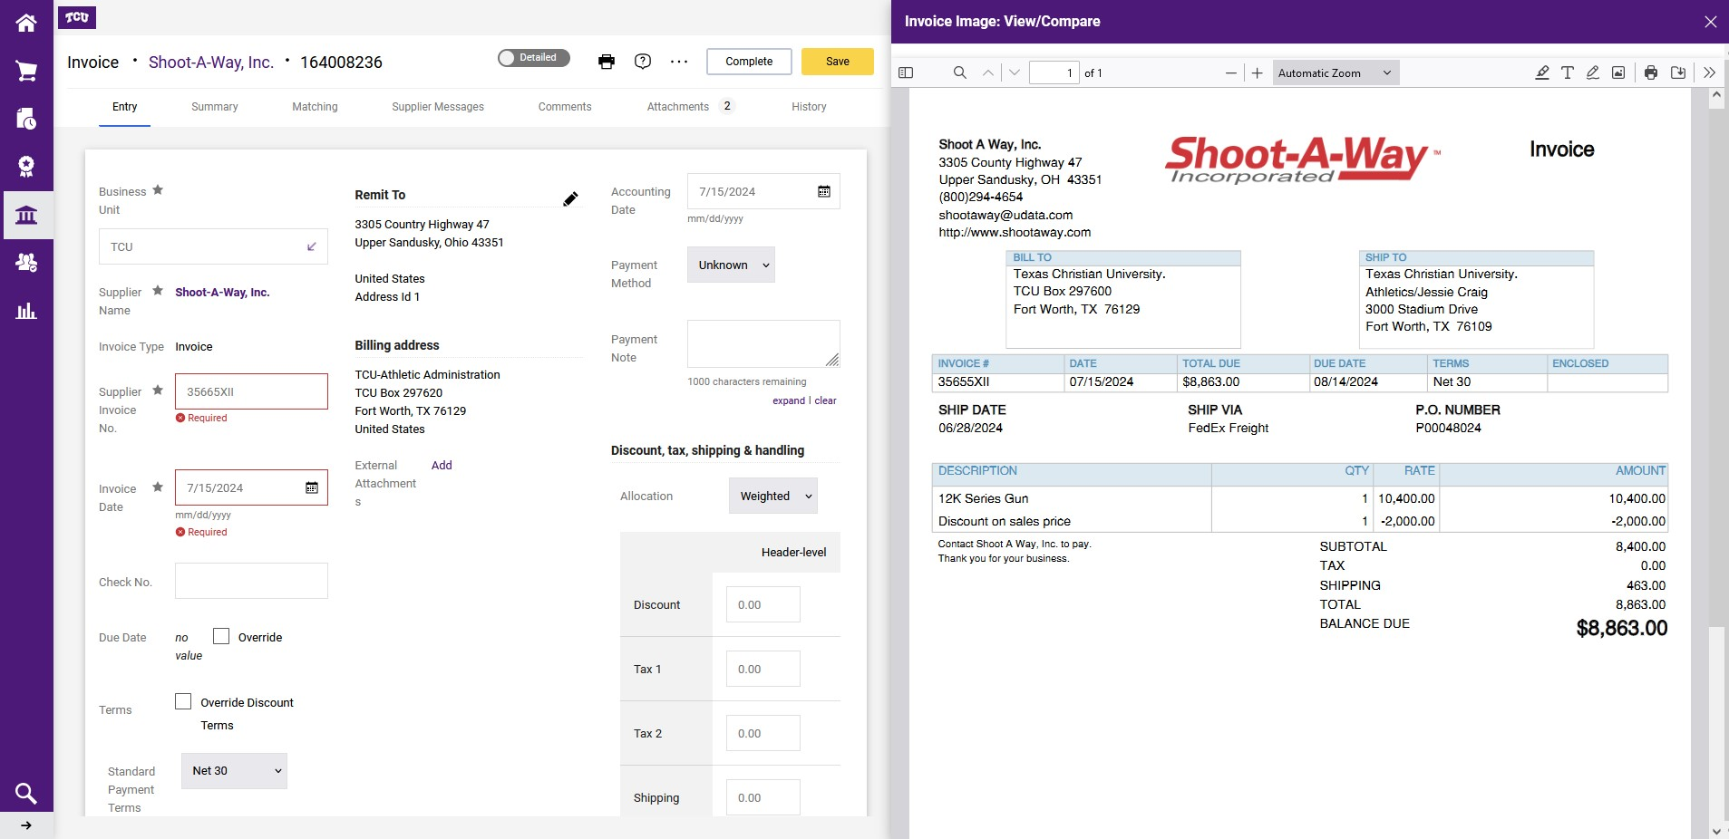
Go back to the 'Entry' tab and fill in the Supplier Invoice Number and the Invoice Date.
Make sure that the ‘Remit to’ address matches the invoice, if not select the ‘pencil’ icon to select the correct address.
Scroll down and make sure the line items in Jaggaer match the final line items on the invoice, and edit if necessary.

Slide 5
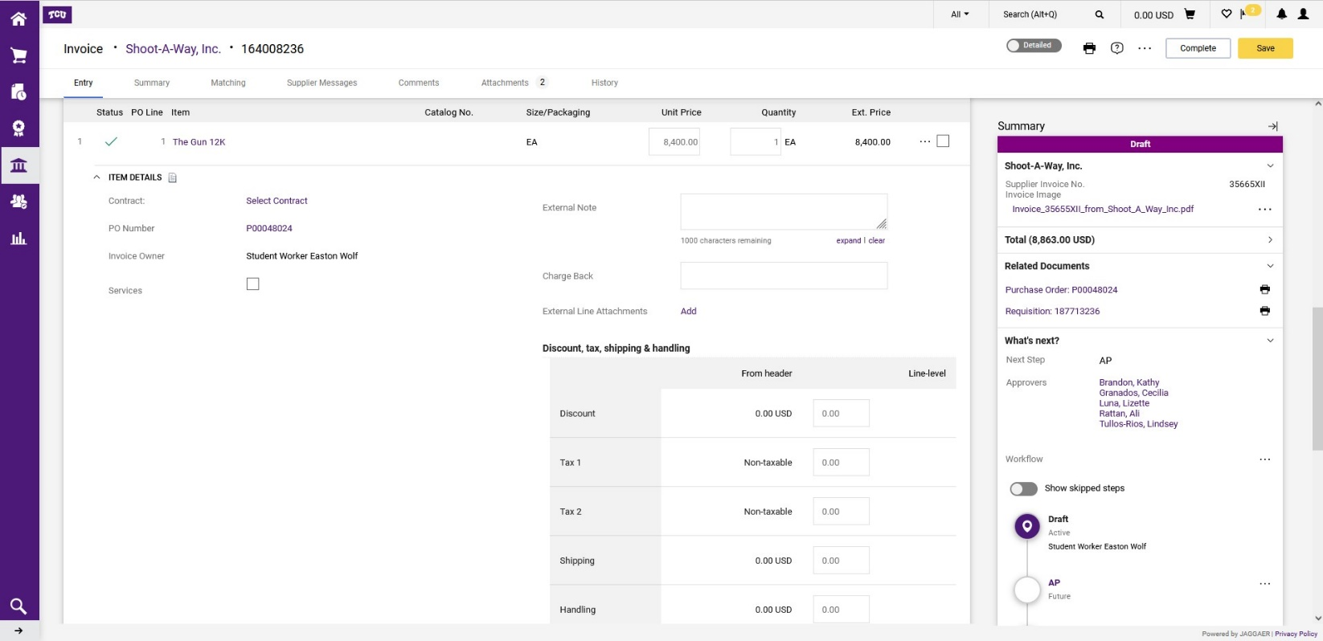
If all lines and total match the invoice then select 'Complete' at the top right of the page to submit the invoice.
If you are paying partial shipment or invoice, revise the quantity on the line for goods purchase orders received. If this is a services invoice, the amount that you are paying. Note: Do not zero out the remaining lines that have not been received.

Slide 6
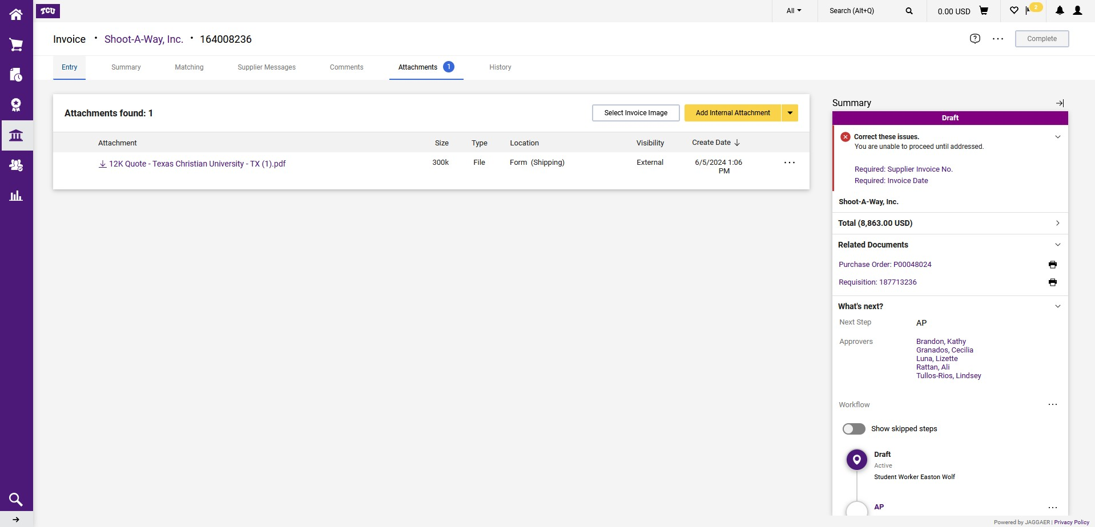
Locate your original purchase order in Jaggaer.
Go to the ‘Attachments’ tab located at top-middle of the page and attach a copy of the Invoice then select Complete top right to submit.

Slide 7
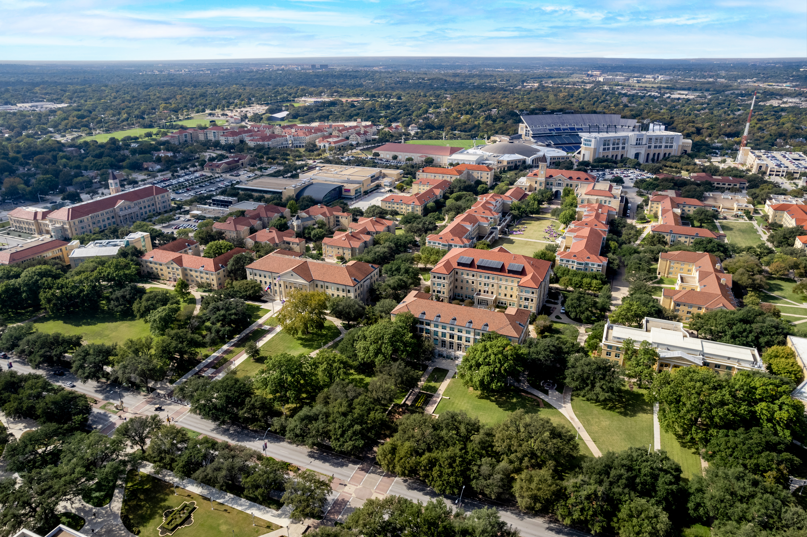
QUESTIONS?
Submit to procurement@tcu.edu

