Slide 1
JAGGAER PREFERRED SERVICE PROVIDERS TRAINING GUIDE
August 2025

Slide 2
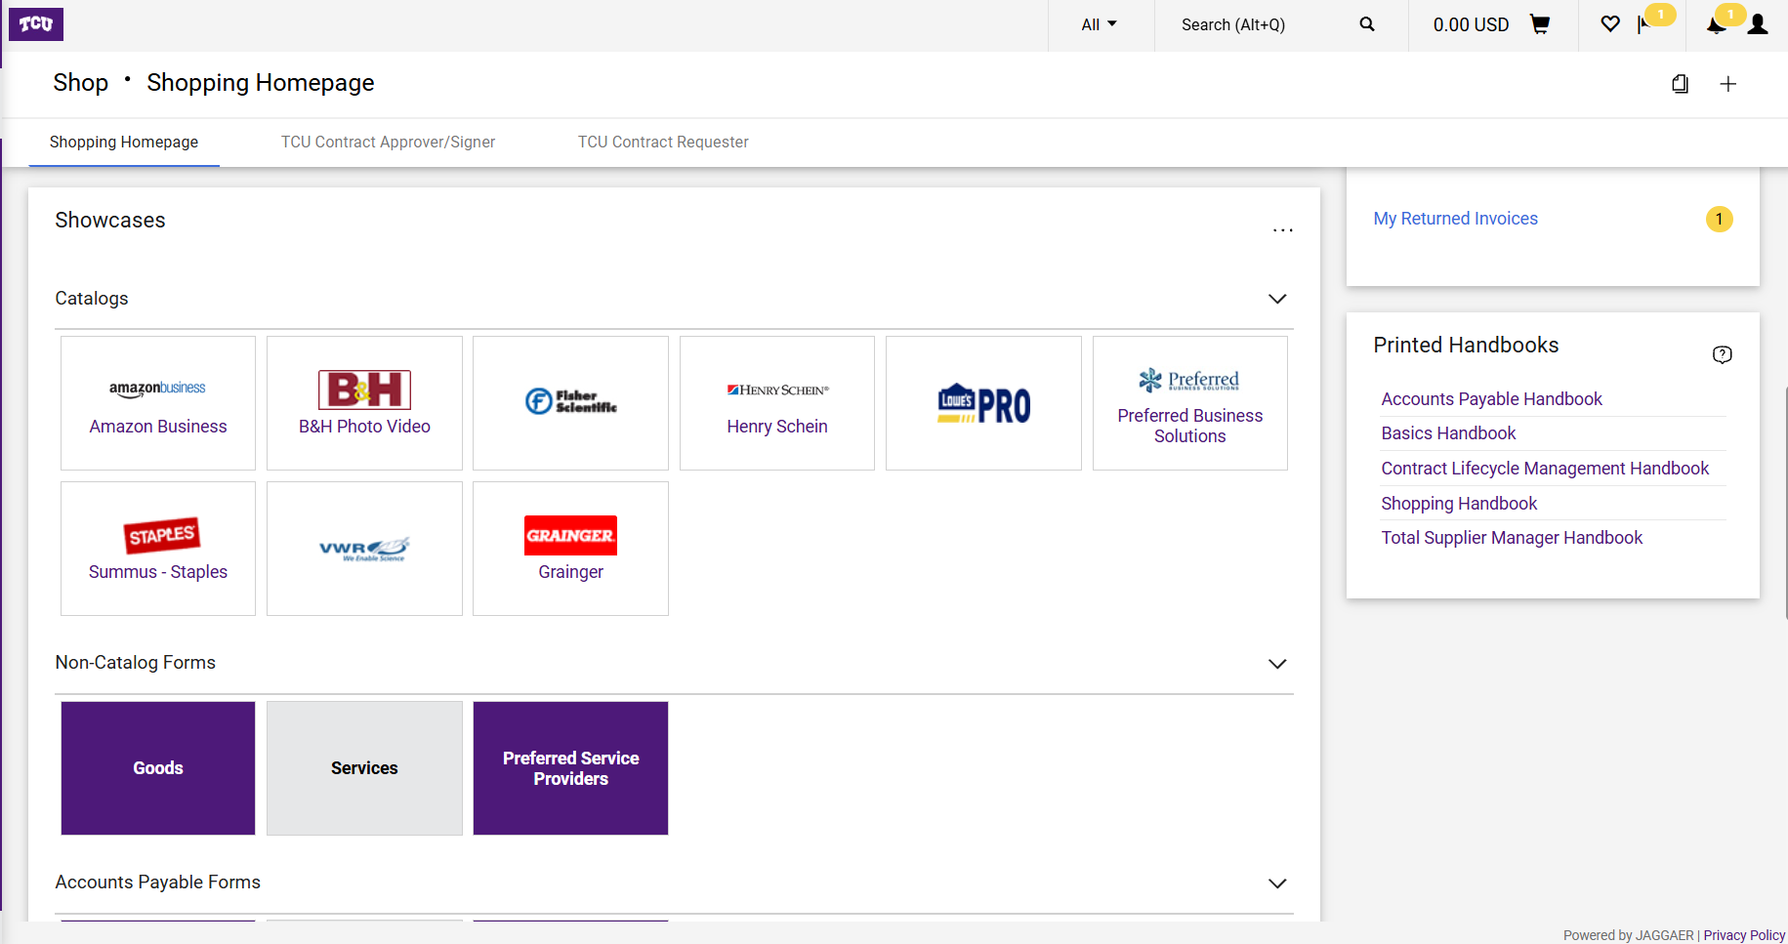
Preferred Service Providers: "Preferred Service Providers" are vendors or suppliers that have been designated by TCU as the preferred choice for a particular category, either through a specific or university-wide contract.
View the Preferred Service Provider List.

Slide 3
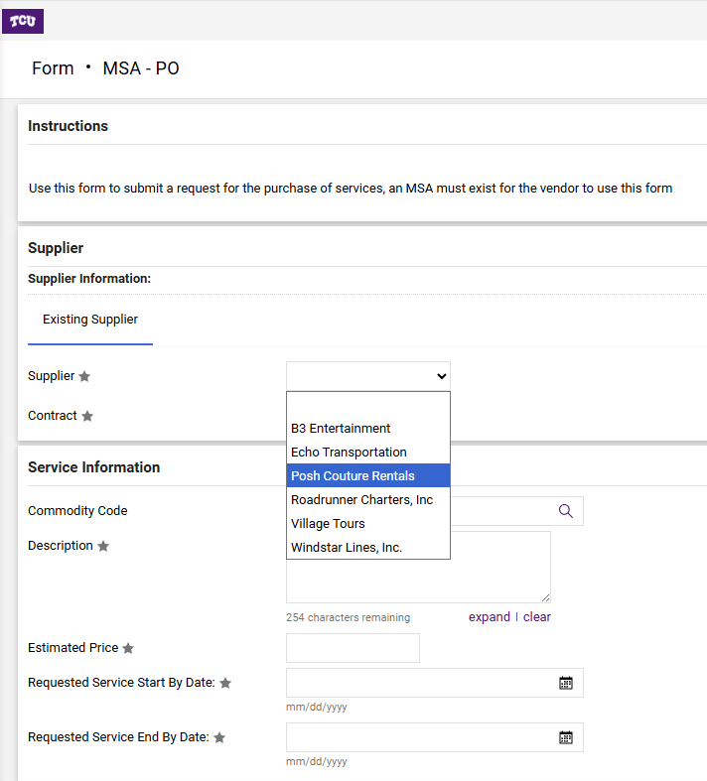
Once the Preferred Service Providers form is clicked, select from the drop down the Supplier Name.

Slide 4
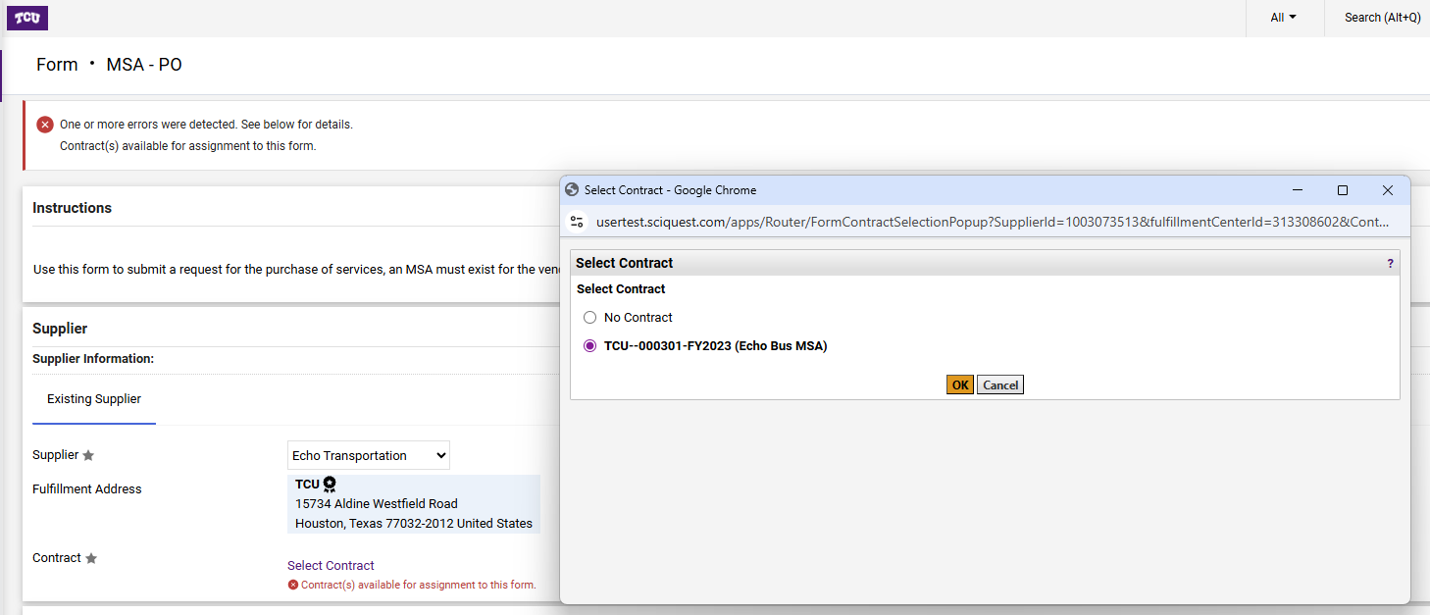
Once the correct Supplier is selected, select the contract associated with the Supplier then click on “OK”.

Slide 5
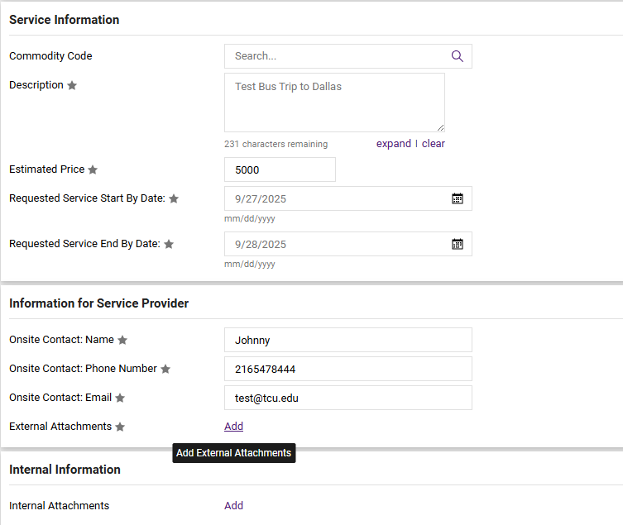
Fill out the information on the form as requested. When filling out “Information for Service Provider” section, this is TCU’s contact information.
ALL STAR “*” FIELDS MUST BE FILLED WITH INFORMATION

Slide 6
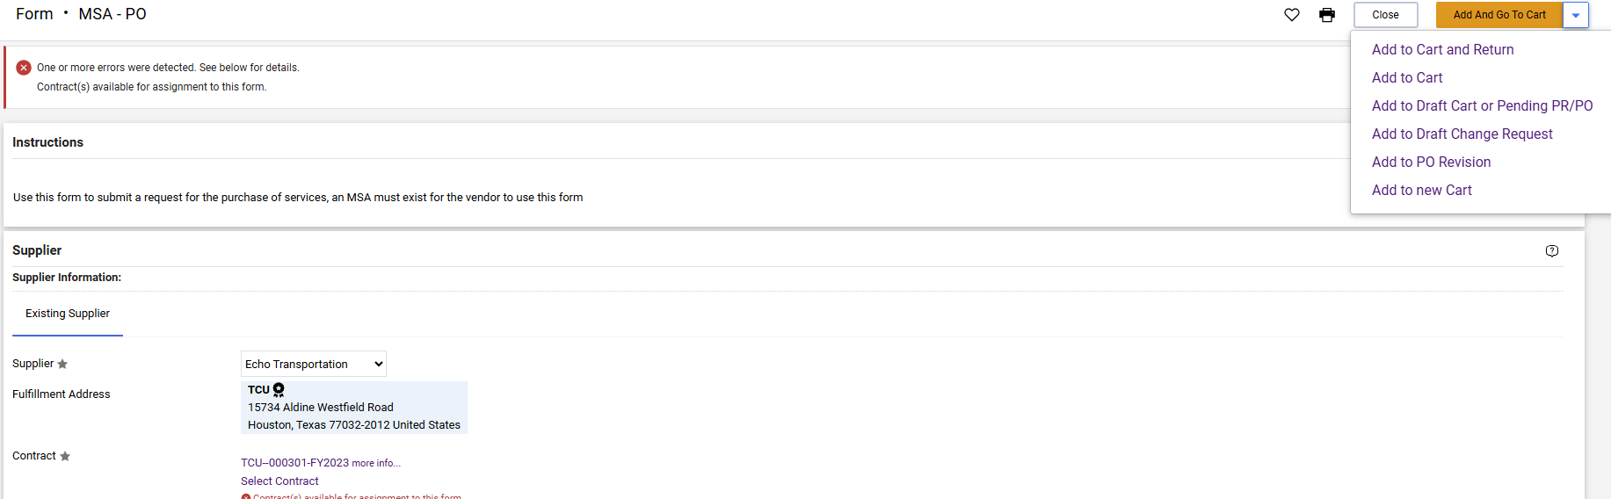
The details entered should “match” exactly the quote that the supplier has provided. If your quote has multiple lines/charges, select the drop arrow and select “Add to Cart and Return” and continue to add until all lines are added. Once all the lines of the order are added to the requisition, review to ensure that it is correct.
Once all correct, click on the large “orange” box to continue.

Slide 7
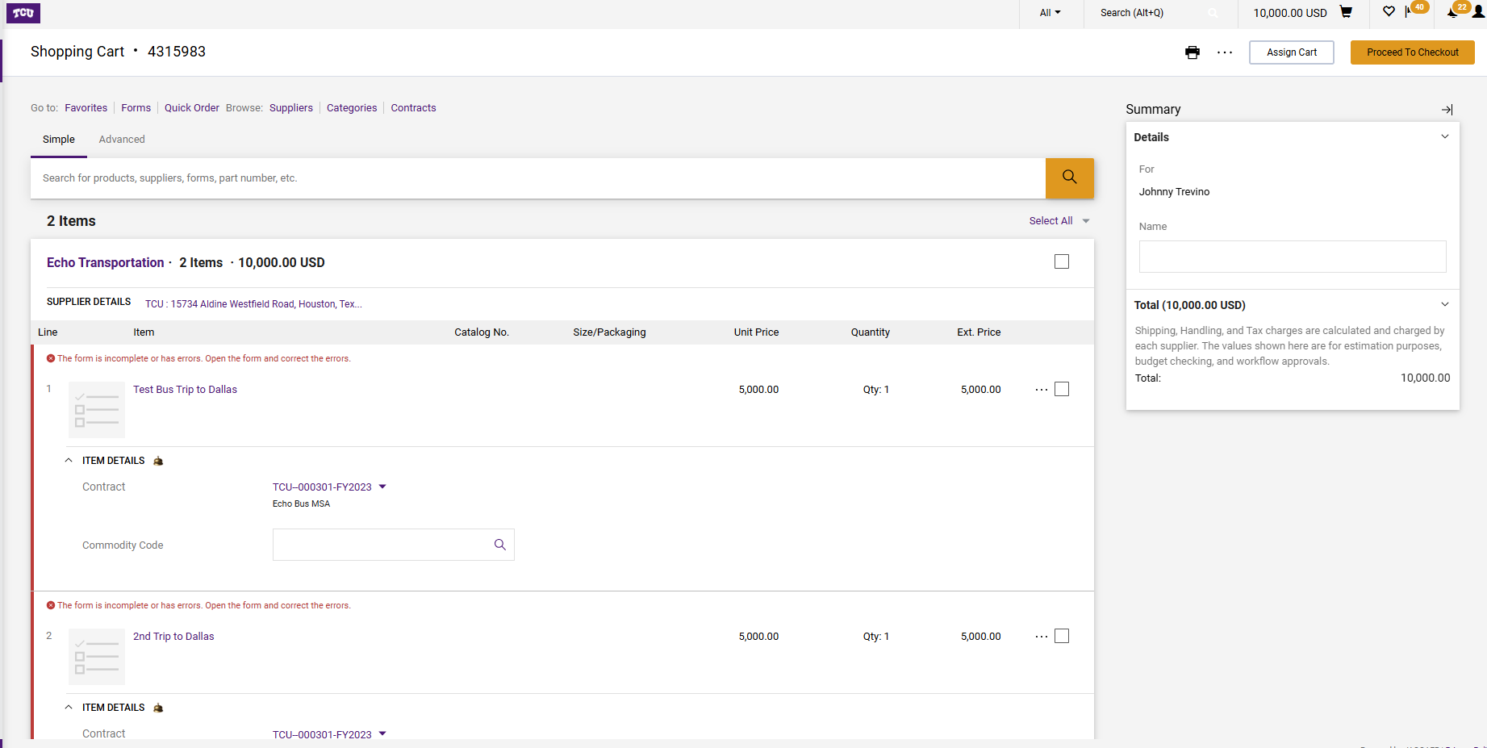
Review the lines to ensure all information is accurate, then select “Proceed to Checkout”.
If the individual who is making this request is not a Requester, must “Assign Cart” to a Requester to finalize the requisition. Once the assign cart is clicked, search and select the correct Requester. If there are any “errors/issues” correct the issues in order to Proceed to Checkout.

Slide 8
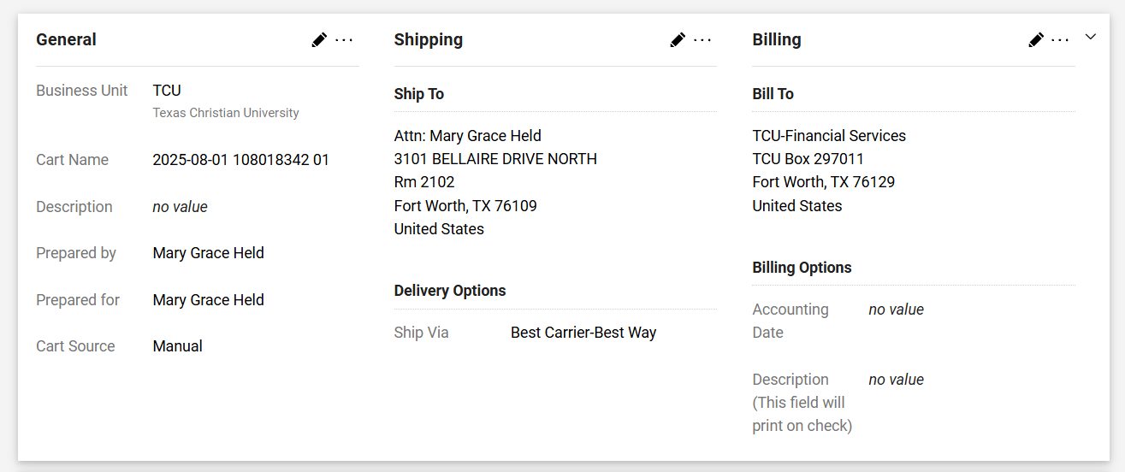
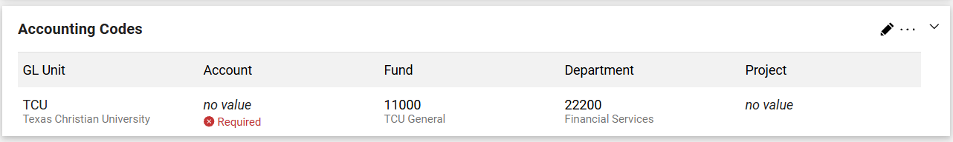
Confirm the Shipping/delivery address and Accounting Codes are correct. If they need to be revised select the “pencil” by those sections to revise.

Slide 9
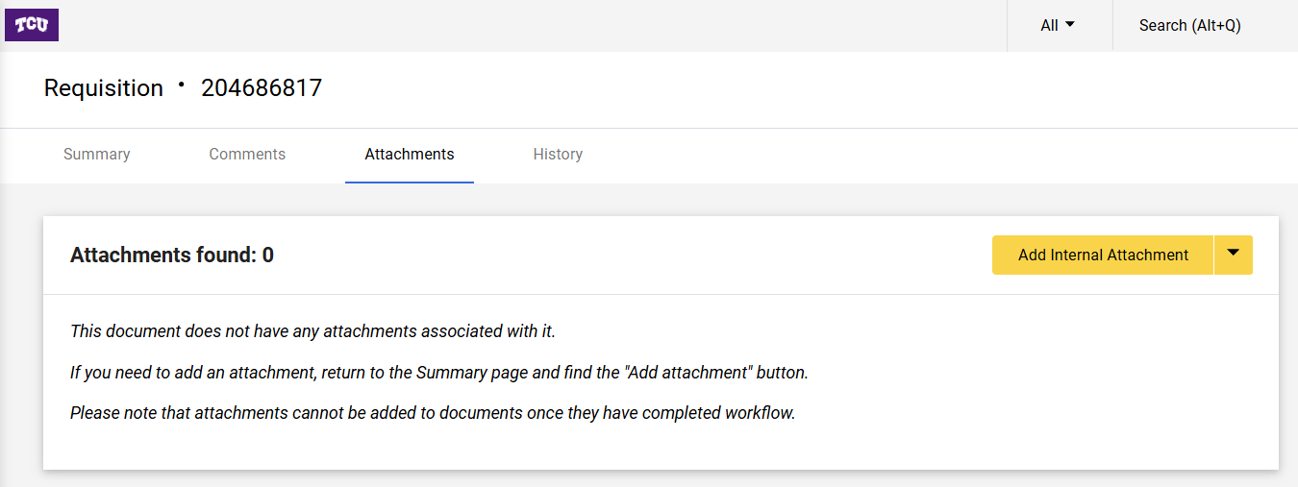
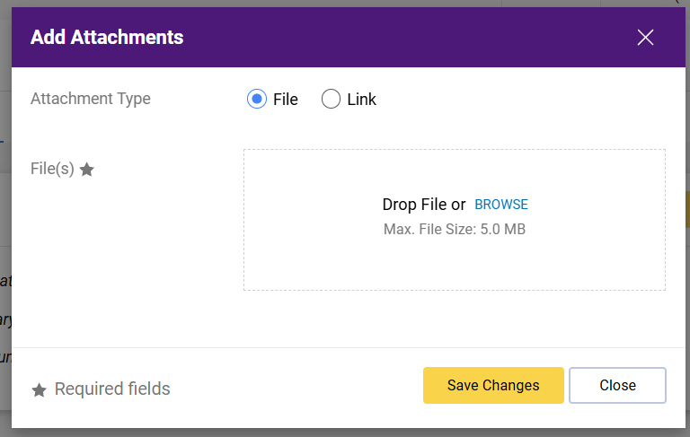
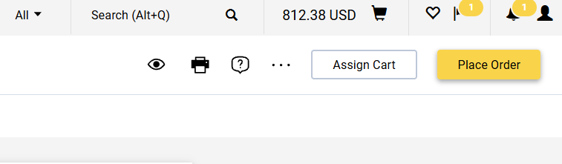
A quote or other document must be attached to substantiate the purchase. Select the “Attachments” tab at the top-middle to drag your document into the requisition. Then select “Place Order” once completed.

Slide 10
FINAL STEP
Manual Invoice Process
NOTE: BE SURE TO WRITE THE ORIGINAL PURCHASE ORDER NUMBER ON THE INVOICE IF NOT ALREADY IDENTIFIED.
Locate PO in Jaggaer
Go to the ‘Attachments’ tab located at top-middle of the page and attach a copy of the Invoice
Go to the 'Invoices' tab at the top. Click the “+” sign.
Go back to the 'Entry' tab and fill in the Supplier Invoice Number and the Invoice Date.
Scroll down and make sure the line items in Jaggaer match the final line items on the invoice, and edit if necessary.
Select 'Complete' at the top right of the page to submit the invoice.
NOTE: REFER TO THE SEPARATE MANUAL INVOICE STEP BY STEP GUIDE FOR MORE DETAILED INSTRUCTIONS AND SCREENS.

Slide 11

QUESTIONS?
Submit to procurement@tcu.edu

